Slide 1
Ecommerce Application - mCart
High-Level Architecture & Design
NAGP Assignment Shivam Sharma

Slide 2
Agenda
Introduction & Objectives
System Overview
Key Requirements & NFRs
High-Level Solution Architecture
Core Services Overview
Integration Architecture
Deployment Architecture
Data Architecture
Technology Stack
Key Design Decisions & Trade-offs
Summary & Future Enhancements

Slide 3
Introduction
Objective of the Platform
Build a scalable, secure, cloud-native e-commerce system
Support high traffic, peak sales, and future growth
Key Capabilities
Product discovery & search
Cart & checkout
Secure payments
Order & inventory management
Notifications & analytics

Slide 4
System Overview
Application Characteristics
Web-based application (mobile-ready)
Microservices-based backend
Event-driven where applicable
Cloud-native on Google Cloud Platform
Users
Customers
Admin/Operations users

Slide 5
Key Non-Functional Requirements
Scalability
Performance
Horizontal scaling
Stateless services
Home page ≤ 3s
Search ≤ 2s (api response + rendering)
Availability
Security
99.9% uptime
No single point of failure
OAuth2 / JWT
No card data storage
Encryption in transit & at rest

Slide 6
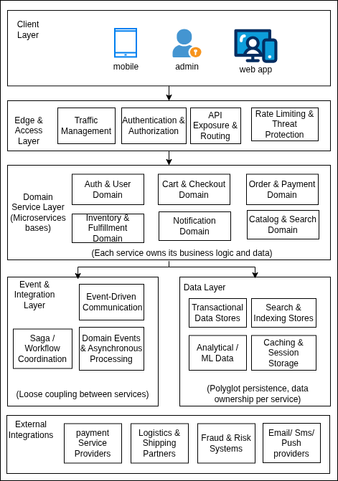
Logical Architecture Overview
Architecture Layers
Client Layer
Edge Layer (API Gateway)
Core Domain Services
Event-Driven Services
External Integrations
Key Principles
Loose coupling
Database per service
Asynchronous communication

Slide 7
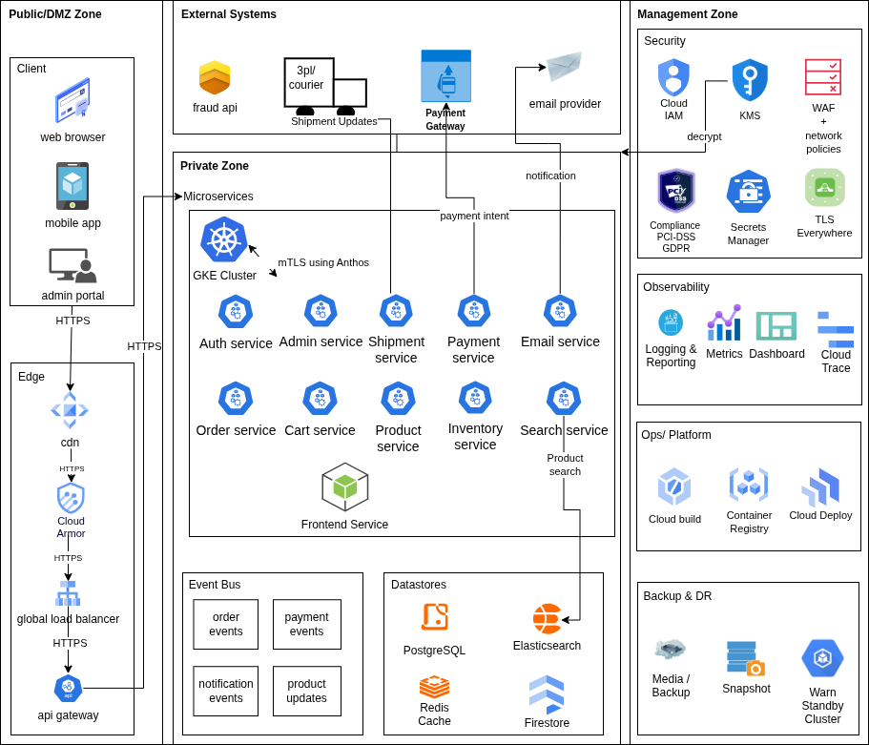
High-Level Solution Architecture
Architecture enables
High Availability
Independent Service Evolution
Secure Integrations
Operational Resilience
This architecture enables the platform to be ready for large-scale e-commerce workloads.

Slide 8
High-Level Solution Architecture
Key Architectural Highlights
Scalability, Observability & Operations
Public/DMZ Zone handles client access via CDN, WAF, Load Balancer, and API Gateway.
Private Zone hosts all core microservices and business logic.
Management Zone manages security, observability, CI/CD, and operational controls.
External Systems remain outside the trust boundary and are accessed via secure integrations.
Horizontal scaling of stateless services.
Centralized logging, metrics, tracing, and dashboards.
Automated CI/CD pipelines with containerized deployments on Kubernetes.
Built-in backup and disaster recovery mechanisms.
Microservices & Domain Ownership
Security by Design
Loose coupling
Database per service
Asynchronous communication
Centralized authentication and authorization.
TLS everywhere, secrets management, IAM-based access control.
No sensitive payment data stored within the platform (PCI-DSS compliant).
Event-Driven Architecture
Asynchronous communication via an event bus enables loose coupling.
Domain events drive workflows such as order processing, payment updates, inventory reservation, and notifications.

Slide 9
Frontend Architecture (SSR)
Frontend Design
Communication
Angular-based UI
Server-Side Rendering (SSR)
Deployed inside GKE cluster
HTTPS via GCP API Gateway
Benefits
Faster initial page load
Improved SEO
Better performance on low-end devices

Slide 10
Core Backend Services
Core Domain Services
Each service:
Product Catalog Service
Search Service
Cart Service
Order Service
Inventory Service
Payment Service
Notification Service
Product-indexer Service
Independently deployable
Owns its data
Horizontally scalable

Slide 11
Authentication & Security
Security Practices
Authentication
In-house Authentication
Email/password & social login
TLS everywhere
Least privilege
No sensitive data exposure
Authorization
JWT validation at API Gateway
Role-based access control in services
Custom claims

Slide 12
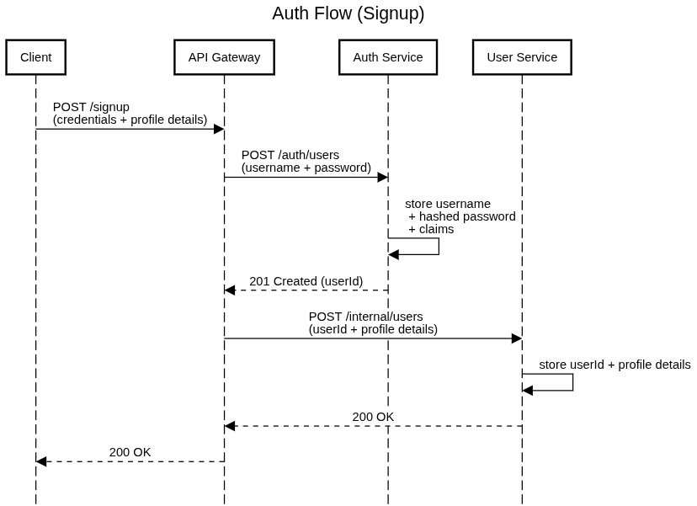
Key Interaction Flows
Sequence Diagrams
1. Sign up

Slide 13
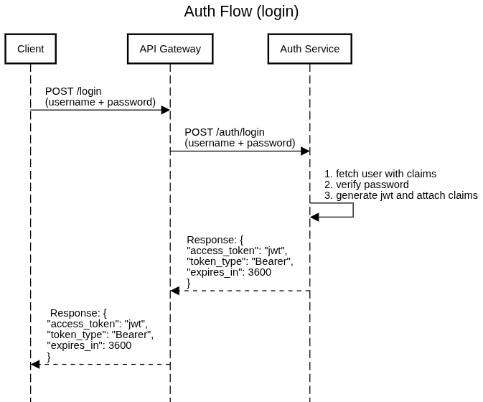
Key Interaction Flows
Sequence Diagrams
2. Login

Slide 14
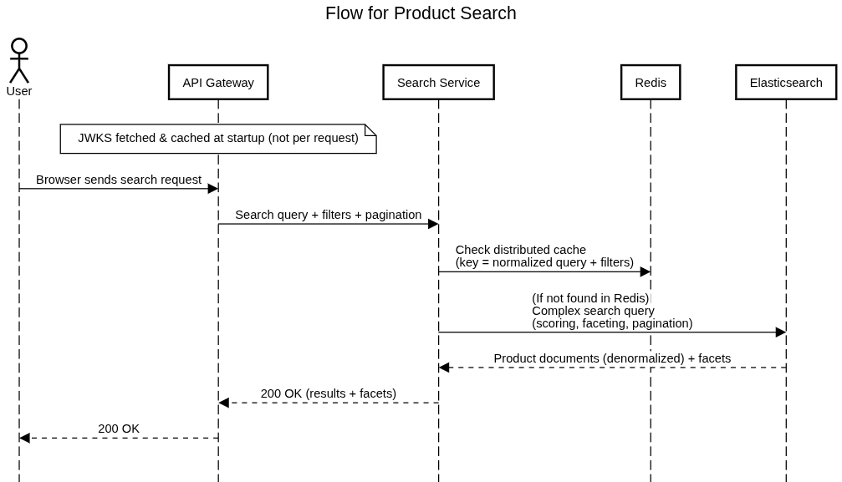
Key Interaction Flows
Sequence Diagrams
3. Product Search

Slide 15
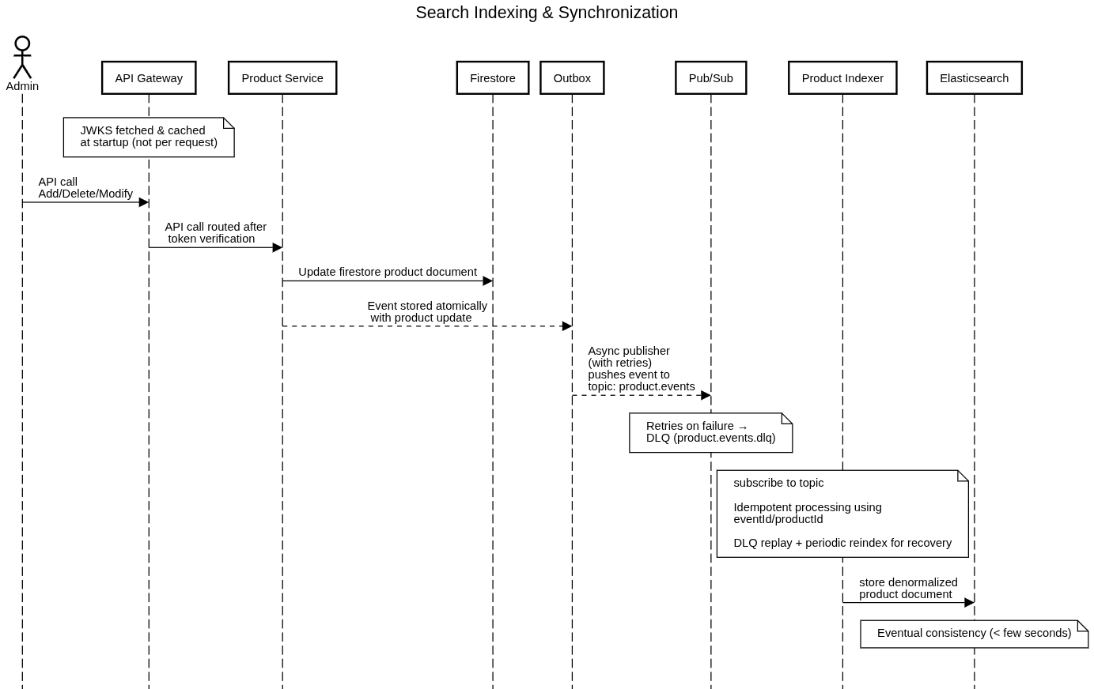
Key Interaction Flows
Sequence Diagrams
4. Search Indexing

Slide 16
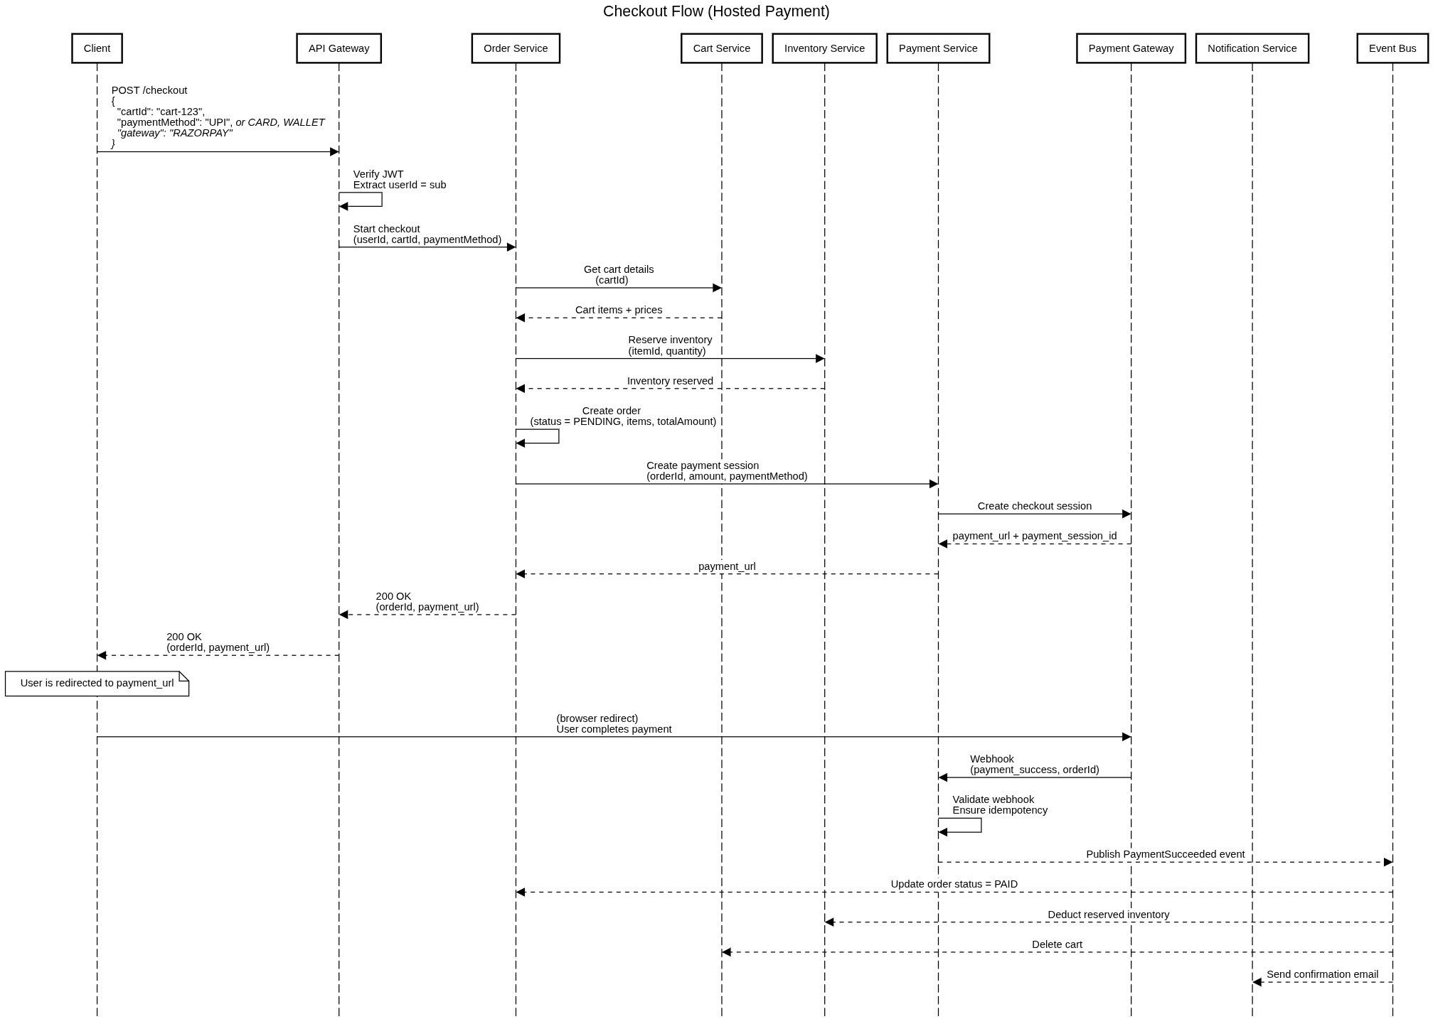
Key Interaction Flows
Sequence Diagrams
5. Checkout

Slide 17
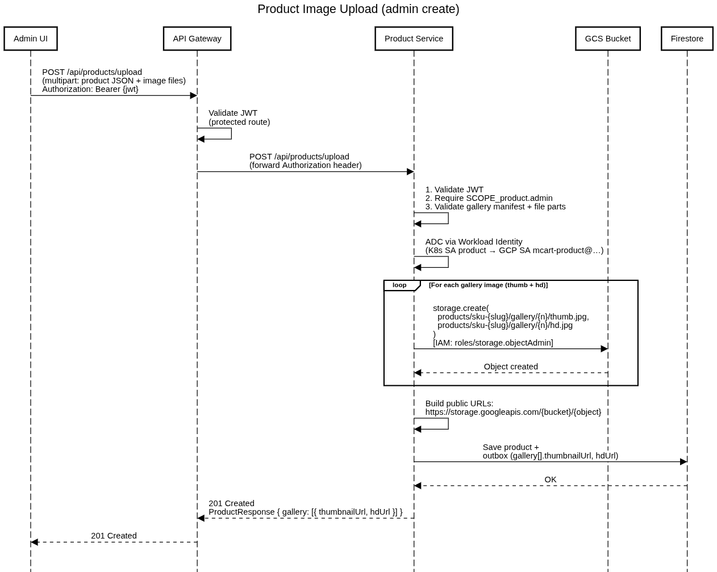
Key Interaction Flows
Sequence Diagrams
6. Image Upload

Slide 18
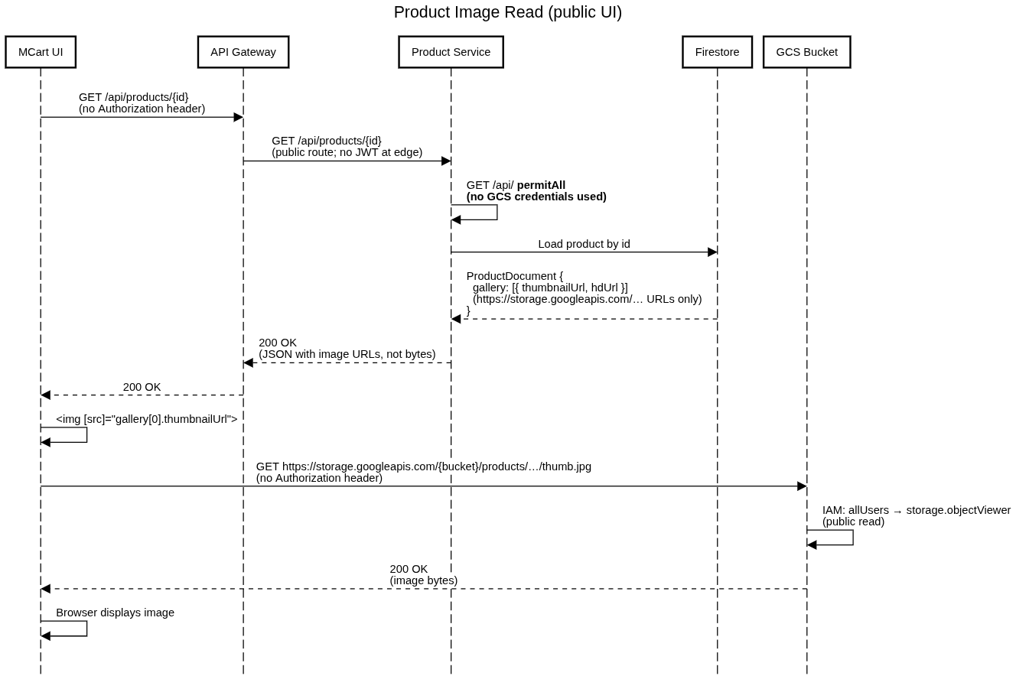
Key Interaction Flows
Sequence Diagrams
7. Image Read

Slide 19
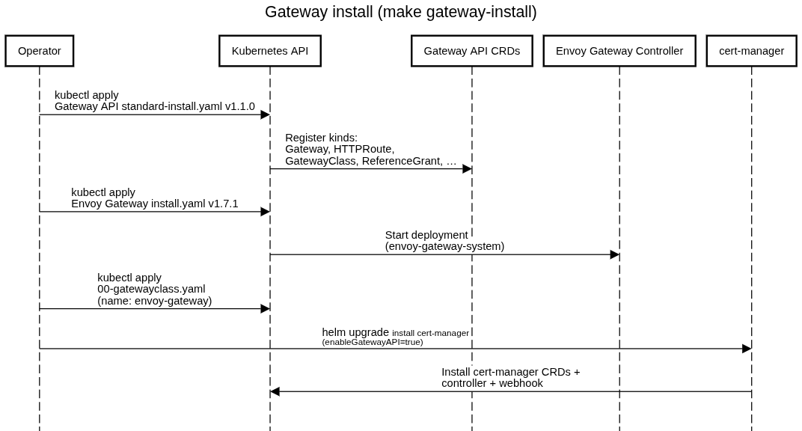
Key Interaction Flows
Sequence Diagrams
8. Gateway install

Slide 20
Integration Architecture
External Integrations
Payment Gateways
Notification Providers (Email/SMS)
Analytics Platforms
Design Approach
No direct frontend-to-external calls
Integration via dedicated services
Timeouts, retries, circuit breakers

Slide 21
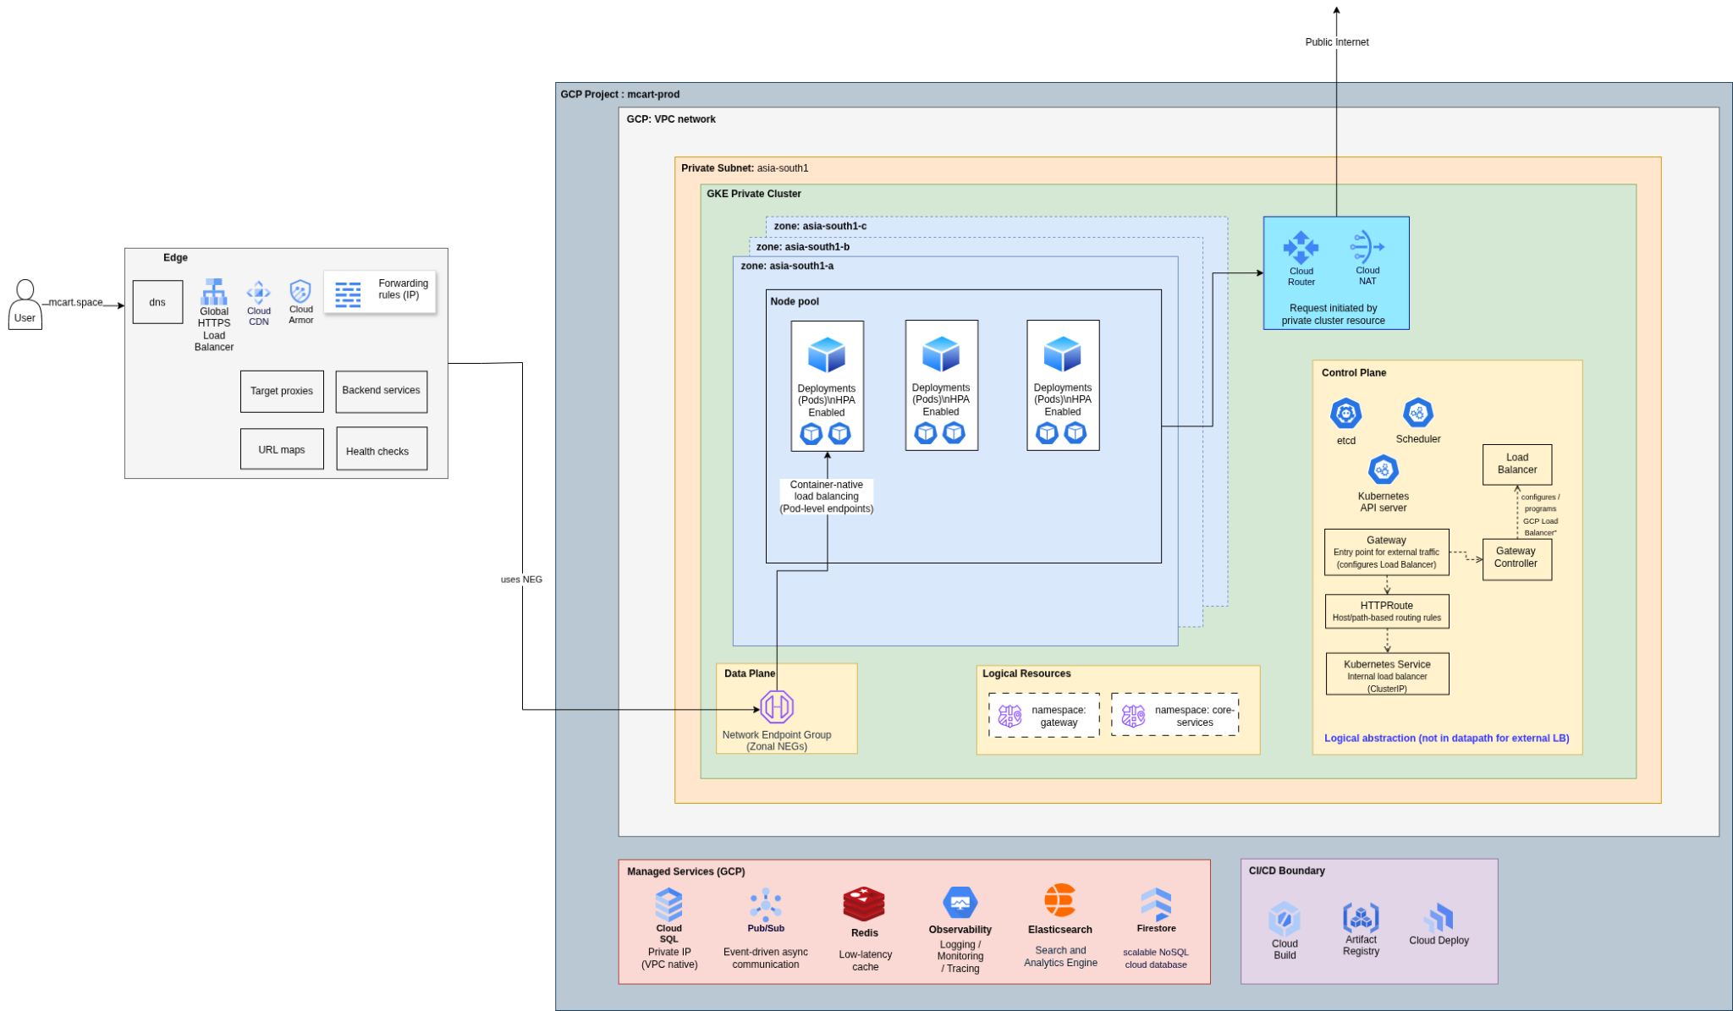
Deployment Architecture
Deployment Model
Containerized microservices
Google Kubernetes Engine
GCP API Gateway as entry point
Zonal Fault-Tolerant via multiple availability zones
GKE Namespace for workload Isolation

Slide 22
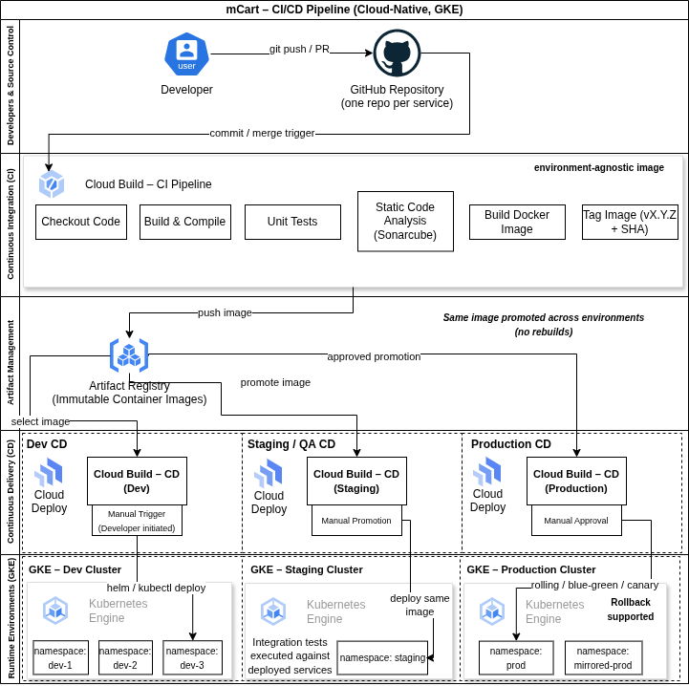
CI/CD & DevOps
CI/CD Pipeline
Cloud Build
Automated testing
Docker image creation
Push to Artifact Registry
Deploy to GKE
Key Principles
Build once, deploy many
Immutable deployments
Automated rollbacks
‹#›

Slide 23
Data Architecture
Polyglot Persistence
PostgreSQL – Orders, users, payments, Inventory
Firestore – Product catalog, Cart
Redis – Cache, sessions
Search index – Full-text search
Consistency Model
Strong consistency: orders, payments, inventory
Eventual consistency: analytics, reports

Slide 24
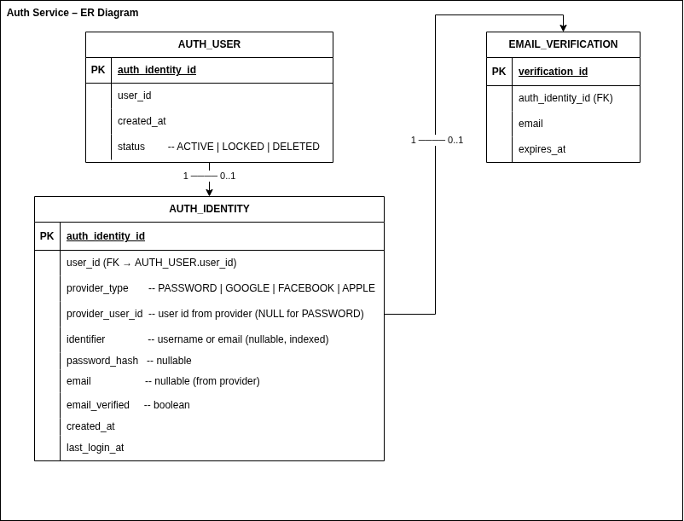
High-Level Entity Relationship Diagram
The following Auth Domain ER diagram represents the core business entities and their relationships at a conceptual level.

Slide 25
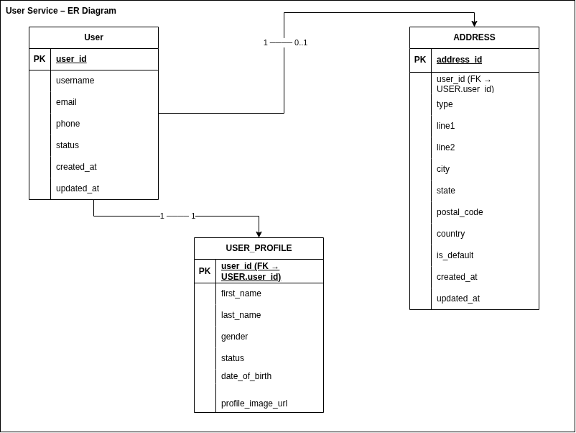
High-Level Entity Relationship Diagram
The following User Domain ER diagram represents the core business entities and their relationships at a conceptual level.

Slide 26
Technology Stack
Frontend
Backend
Angular, TypeScript, HTML5, CSS3
Java 17, Spring Boot, Spring Security
Cloud & Platform
DevOps
GCP, GKE, API Gateway
Pub/Sub, Cloud Storage
Docker, Terraform, Cloud Build

Slide 27
Key Design Decisions & Trade-offs
Decisions
Custom auth
GKE over VM-based deployment
Event-driven architecture
Trade-offs
Microservices add operational complexity
Custom Authentication & Authorization will add additional complexity and compliance considerations
Eventual consistency for analytics
SSR increases frontend complexity

Slide 28
Summary
What this architecture achieves
Scalability & resilience
Secure & compliant payments
Clean service boundaries
Cloud-native best practices
Architecture is
Production-ready
Extensible
Future-proof

Slide 29
Future Enhancements
Mobile applications
Multi-region deployment
Recommendation engine
Advanced analytics & ML

Slide 30
Q & A
Thank you.

